Slide 1
Overview of CNP Working Group Goals and Progress
2025 LEMONTREE Annual Meeting
2025.08.26

Slide 2
Main goal: review current evidence and develop a theory for understanding optimal plant responses to P availability

Slide 3
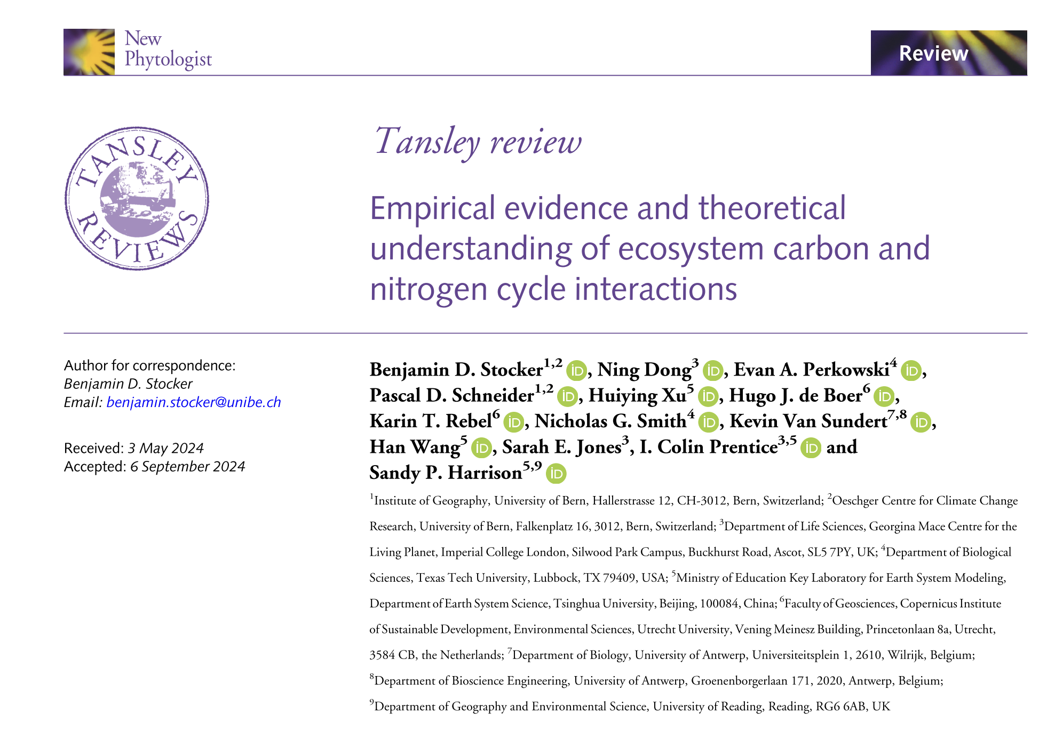

Slide 4
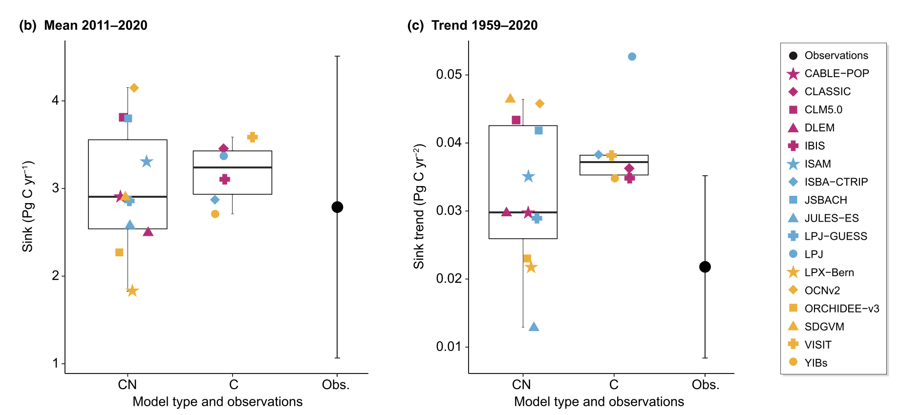
Stocker et al. (2025) New Phytologist
Notes:
Residual land carbon sink

Slide 5
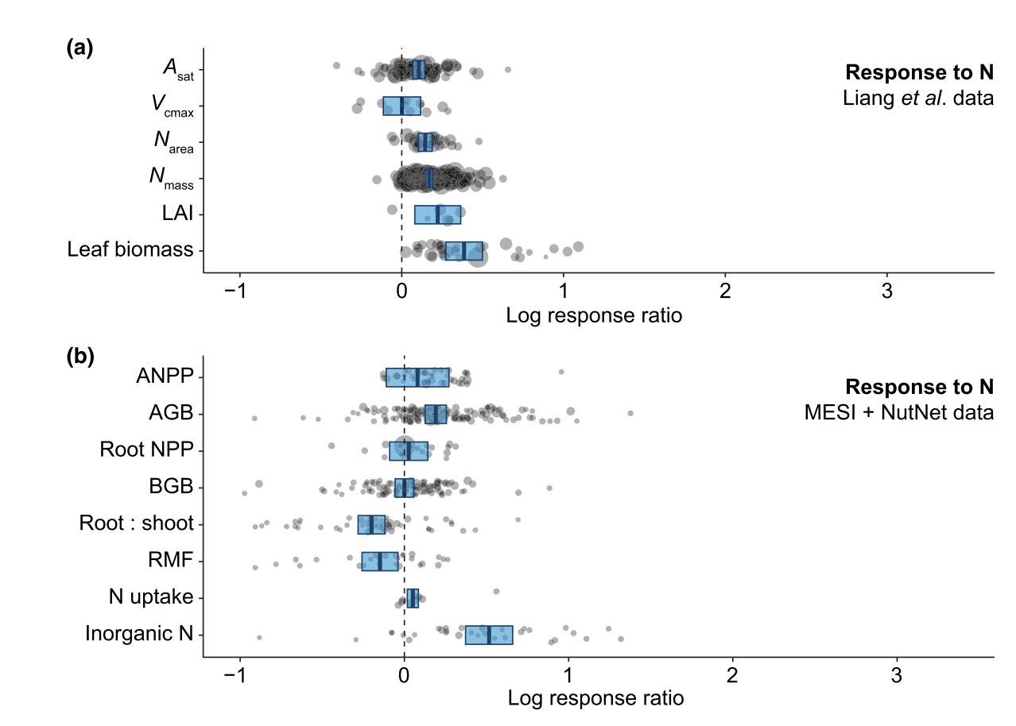
Stocker et al. (2025) New Phytologist

Slide 6
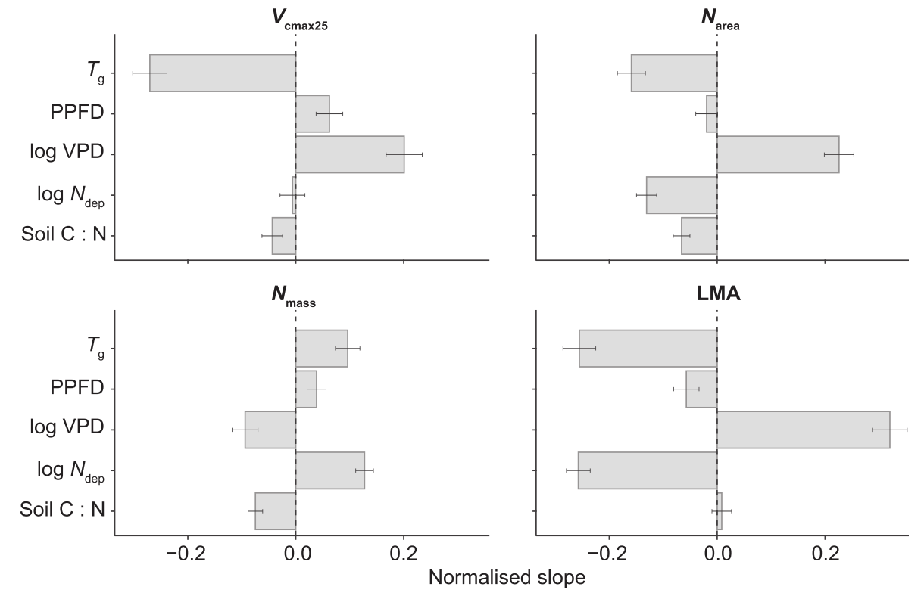
Stocker et al. (2025) New Phytologist

Slide 7
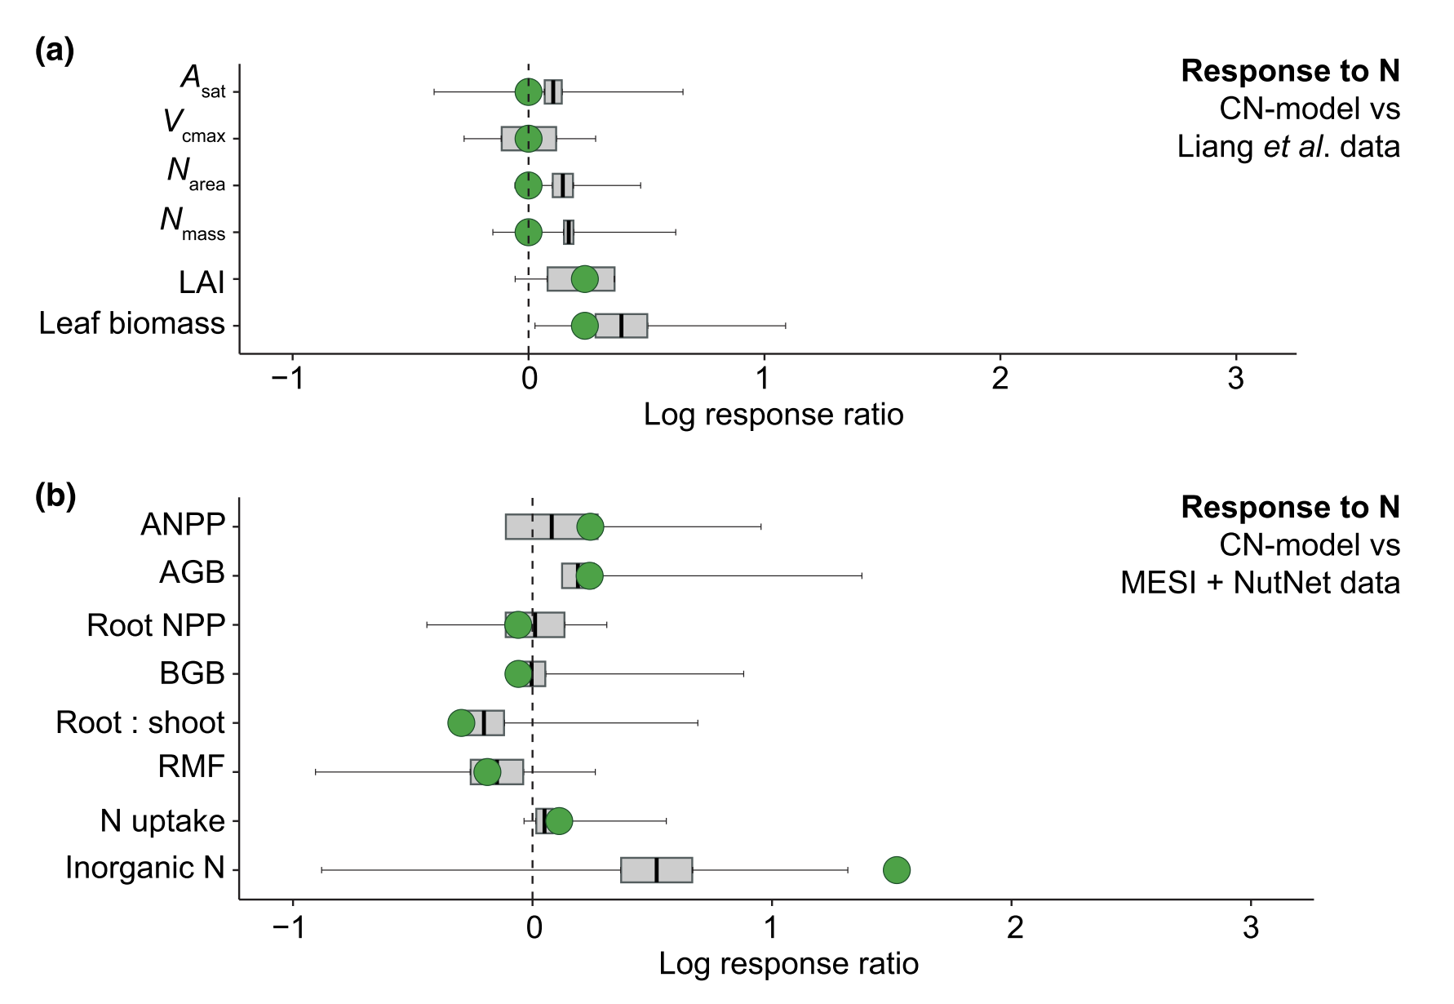
Stocker et al. (2025) New Phytologist

Slide 8
CNP Working Group Progress

Slide 9
CNP Working Group Progress Y4
Task/Working Group Product | Milestone | Proposed Deadline | Notes
6.1 P Cycle Review paper | Report on how phosphorus is currently implemented in models | Dec-24 | Complete, report available
 | Evaluation of simulated C sink trends by models with and without P cycle | Dec-24 | Complete, report available
 | Report on meta-analysis of leaf and whole-plant responses to phosphorus addition | Jan-25 | Complete, report available. Meta-analysis proposed as stand-alone product and review paper display item

Slide 10
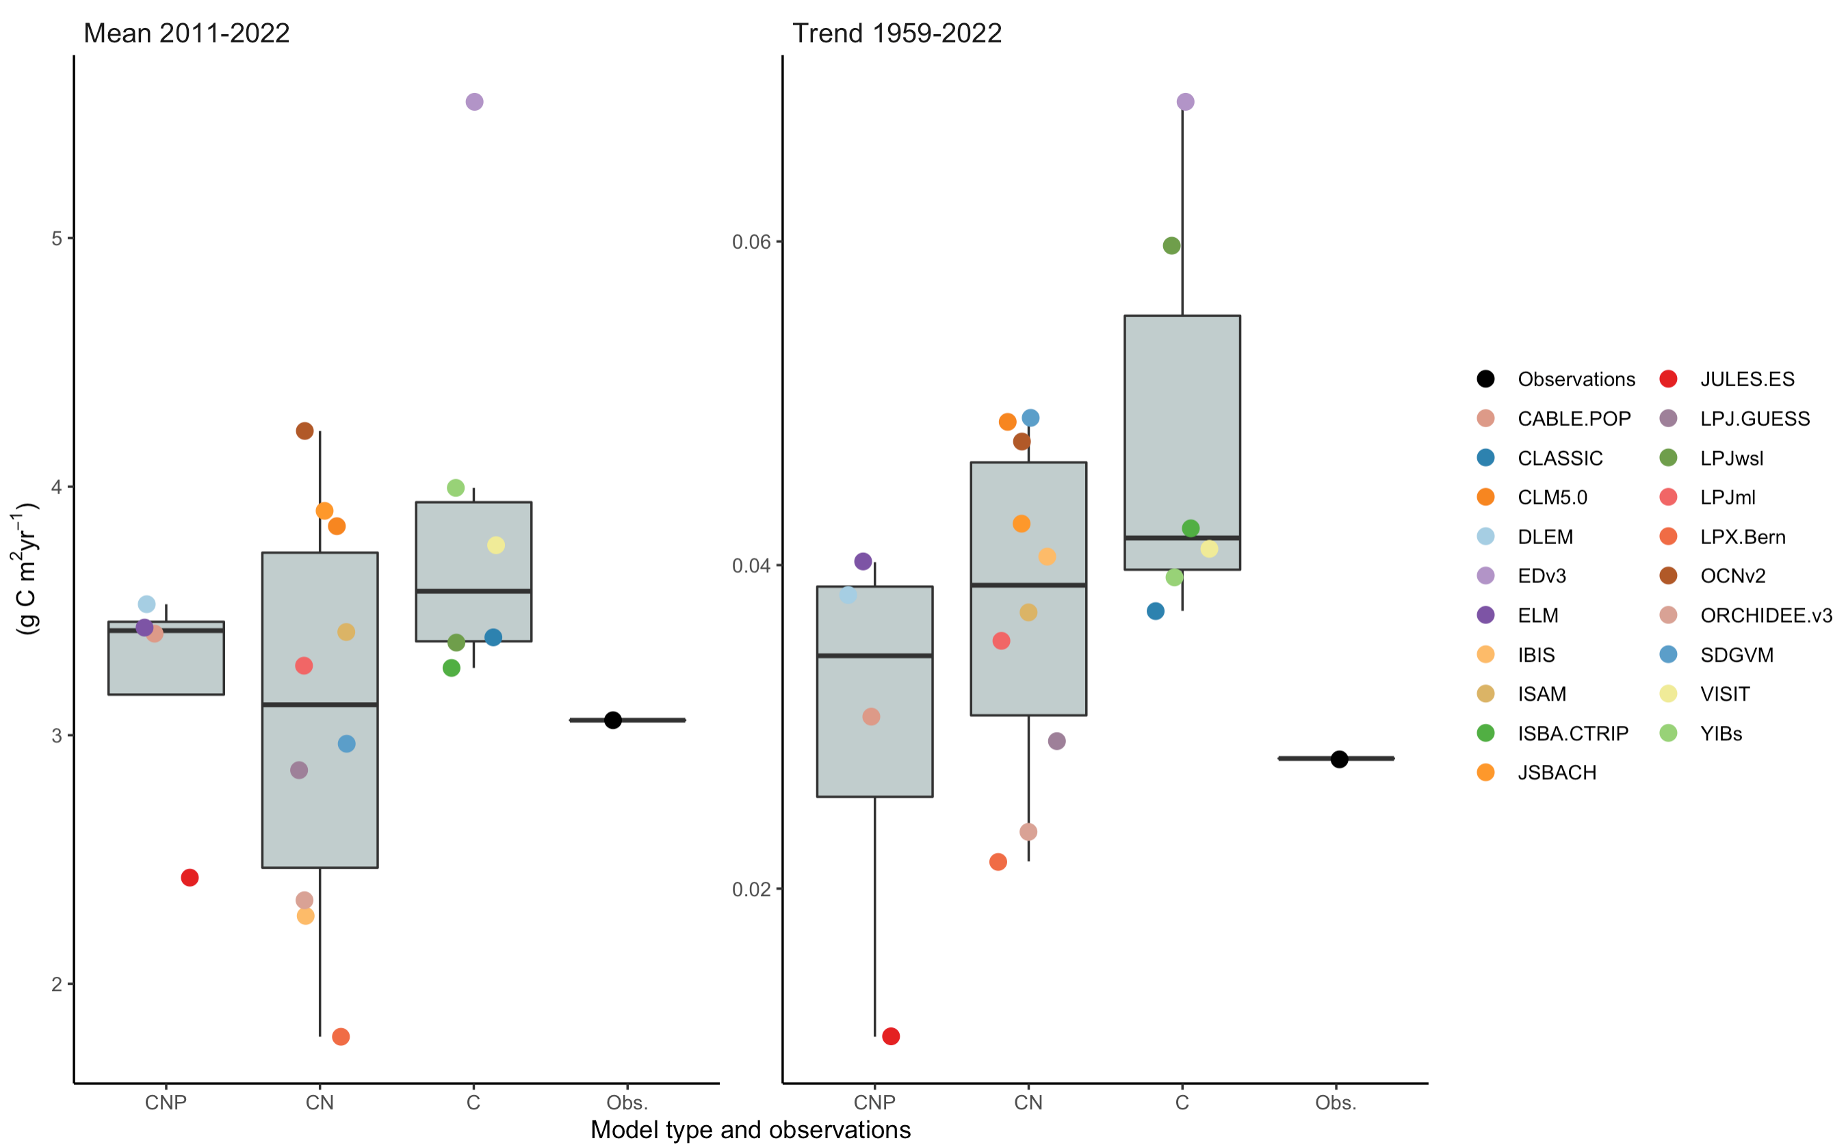
Note: CNP and CN models differ by more than just incorporation of P cycle… next steps are to run model
experiments changing dose of P to isolate effect of P cycle on these trends

Slide 11
CNP Working Group Outlook Y5
Task/Working Group Product | Milestone | Proposed Deadline | Notes
3.13 N and P controls | Meta-analysis | Dec-25 | Meta analysis paper of N, P, N+P addition effects on leaf and whole-plant traits
3.13 N and P controls | P fractionation | Dec-25 (?) | Analysis of leaf phosphorus fractionation data in response to soil and climate variables
3.13 N and P Controls | Theory development | Dec-25 | Meta analysis and analysis of fractionation data has started discussion on hypothesis generation.
6.2 P Cycle Review Paper | Final manuscript | Dec-25 | Nick Smith and Keith Bloomfield agree to lead effort

Slide 12
Global response patterns of plant functional traits to N and P addition are driven by additive interactions and climatic demand
Evan A. Perkowski

Slide 13
Nutrient availability plays an important role in shaping plant ecophysiological trait variation
Notes:
To jump right in, we know that nutrient availability plays an important role in shaping plant ecophysiological traits across time and space

Slide 14
Nutrient availability plays an important role in shaping plant ecophysiological trait variation
Soil nutrients
Leaf nutrients
Notes:
This knowledge is predicated on the fact that increasing soil nutrient availability is often positively correlated with leaf nutrient content…

Slide 15
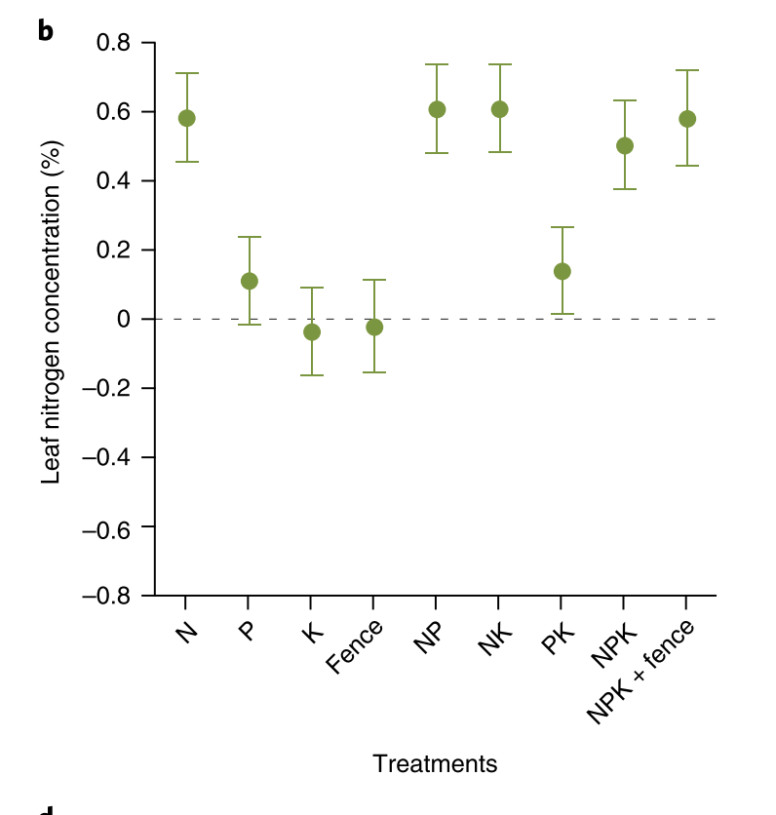
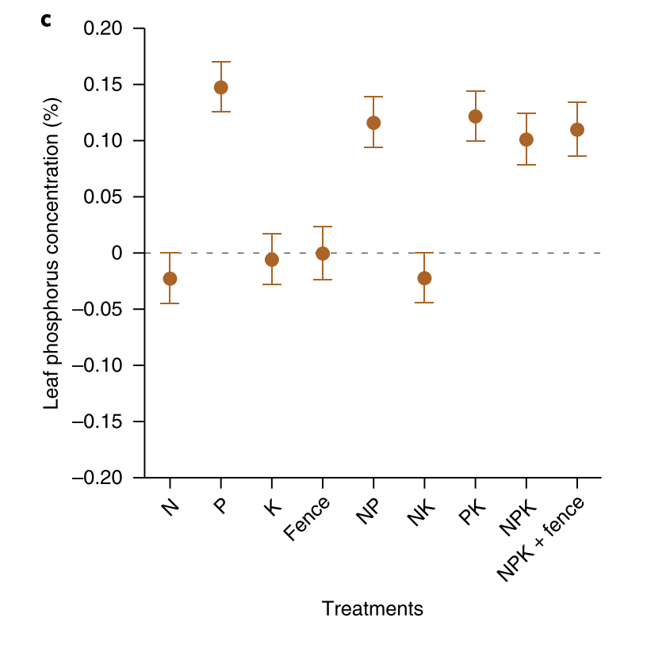
Nutrient availability plays an important role in shaping plant ecophysiological trait variation
Soil nutrients
Leaf nutrients
Firn et al. (2019) Nature Ecology & Evolution
Notes:
For example, Firn et al. (2019) used the Nutrient Network to show that nitrogen addition is associated with increased leaf nitrogen content, and phosphorus addition is associated with increased leaf phosphorus content

Slide 16
Nutrient availability plays an important role in shaping plant ecophysiological trait variation
Soil nutrients
Leaf nutrients
Photosynthesis
Firn et al. (2019) Nature Ecology & Evolution
Notes:
But to take this one step further, leaf nutrients are often positively correlated with indices of photosynthesis or photosynthetic capacity

Slide 17
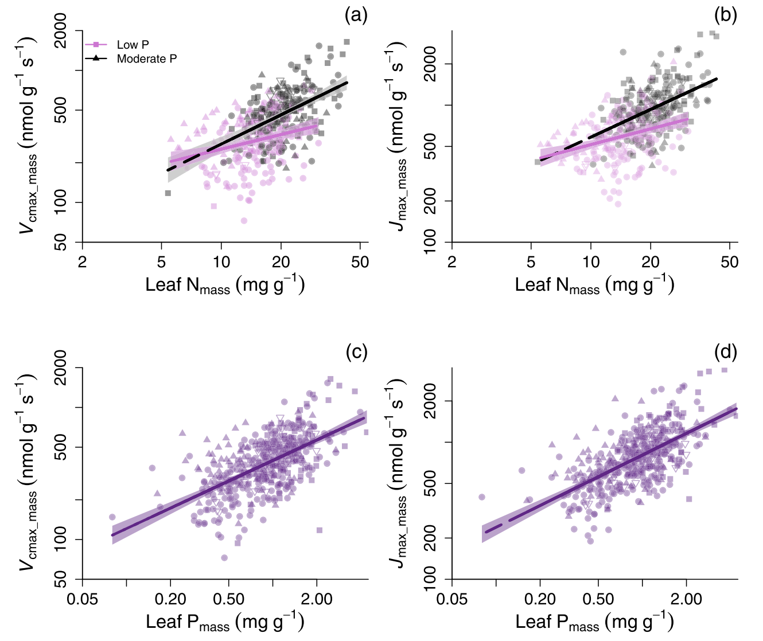
Nutrient availability plays an important role in shaping plant ecophysiological trait variation
Soil nutrients
Leaf nutrients
Photosynthesis
Firn et al. (2019) Nature Ecology & Evolution
Ellsworth et al. (2022) Nature Communications
Notes:
Here is a figure from Ellsworth et al. (2022) showing positive correlations between leaf nitrogen content and an index of photosynthetic capacity…

Slide 18
Nutrient availability plays an important role in shaping plant ecophysiological trait variation
Soil nutrients
Leaf nutrients
Photosynthesis
Firn et al. (2019) Nature Ecology & Evolution
Ellsworth et al. (2022) Nature Communications
Notes:
A correlation that persists when we look at relationships between leaf phosphorus and the same index of photosynthetic capacity

Slide 19
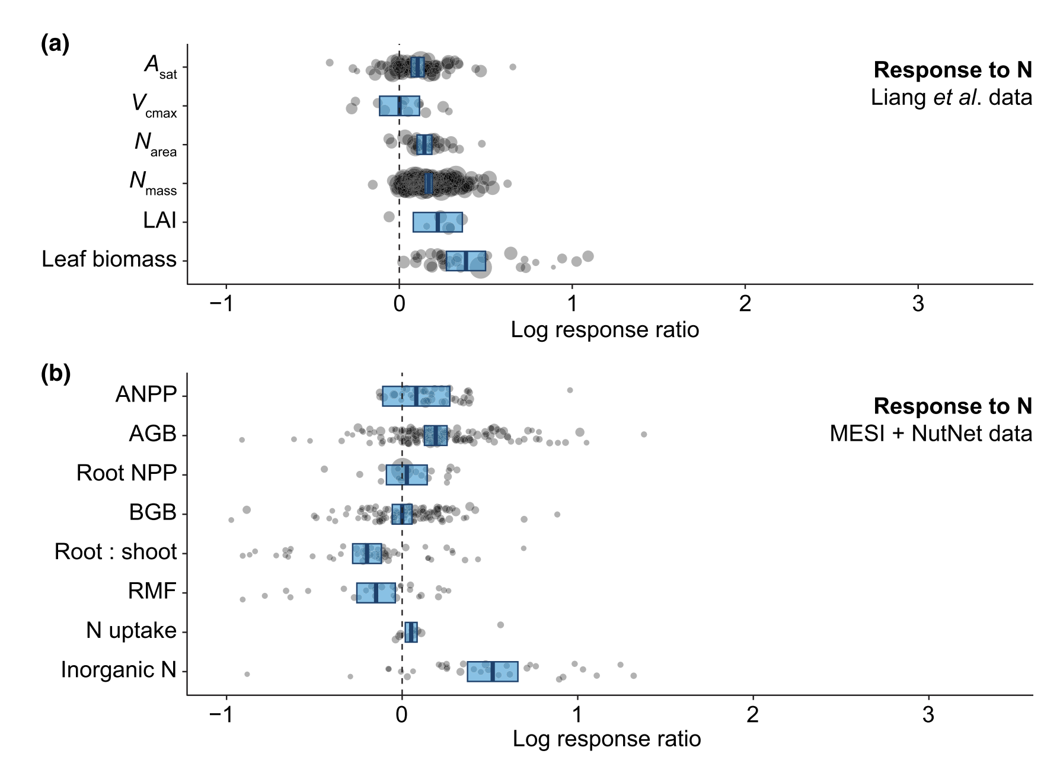
Plant ecophysiological responses to nitrogen availability are well-studied…
Stocker et al. (2025) New Phytologist
Notes:
As it turns out, plant ecophysiological responses to nitrogen availability are well studied.
This is a plot from a meta-analysis we published earlier this year showing leaf and whole-plant trait responses to nitrogen addition.
I don’t want to get into the nitty gritty details here, but I’m just pointing out the sheer number of N addition experiments (noted through the points) that measure plant ecophysiological traits

Slide 20
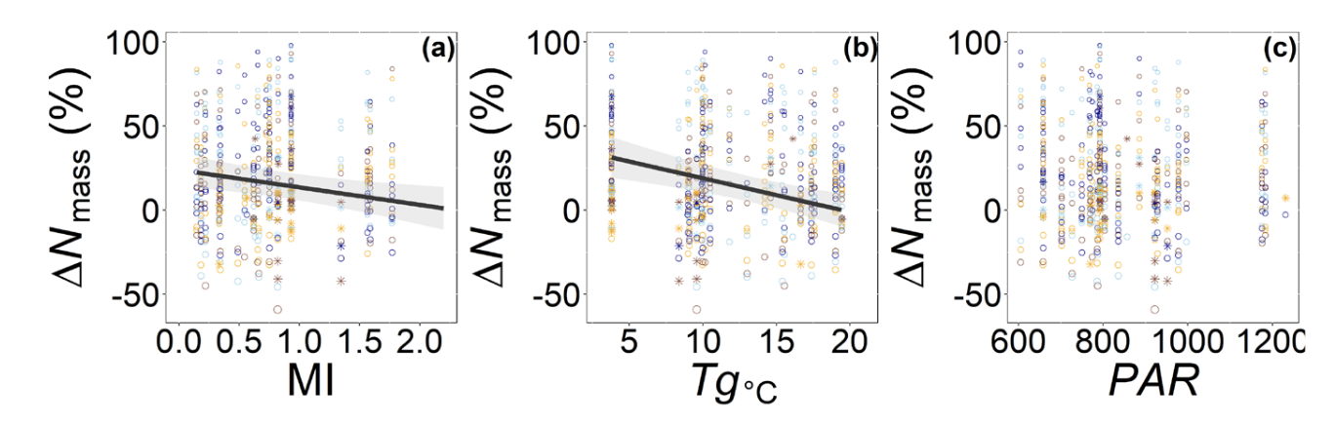
Some responses to nitrogen are context dependent on climatic demand and nutrient acquisition strategy
Leaf N content increases with N addition
most strongly in cold, dry climates
Cheaib et al. (2025) Ecology Letters
Notes:
Recent work from our lab has also shown that plant responses to nitrogen addition are dependent on climate, with stronger positive leaf nitrogen content responses to nitrogen addition in regions with dry and cold climates.
This work suggests that stronger responses to nutrient addition may be apparent when demand for soil nutrients are greatest.
In dry regions, plants can maintain photosynthesis by increasing nutrient uptake and allocation to photosynthetic enzymes to make up for reduced water uptake
Similarly, decreased enzymatic speed under low temperatures increases demand to build and maintain photosynthetic enzymes to achieve a optimize photosynthesis at a given light level.

Slide 21
But what about the role of phosphorus availability?
Energy metabolism (ATP and NADPH drive photosynthetic and respiratory reactions)
Carbon export (sucrose transport relies on triose phosphate utilization)
Biomass allocation to root tissues (to satisfy demand for above processes)
Notes:
Ok, so we know a fair bit about plant responses to nitrogen availability.
But what about the role of phosphorus?
As with nitrogen, phosphorus plays important roles in energy metabolism, carbon export, and biomass allocation to root tissues
As such, one might expect plants to respond to changes in phosphorus availability in a similar manner as nitrogen

Slide 22
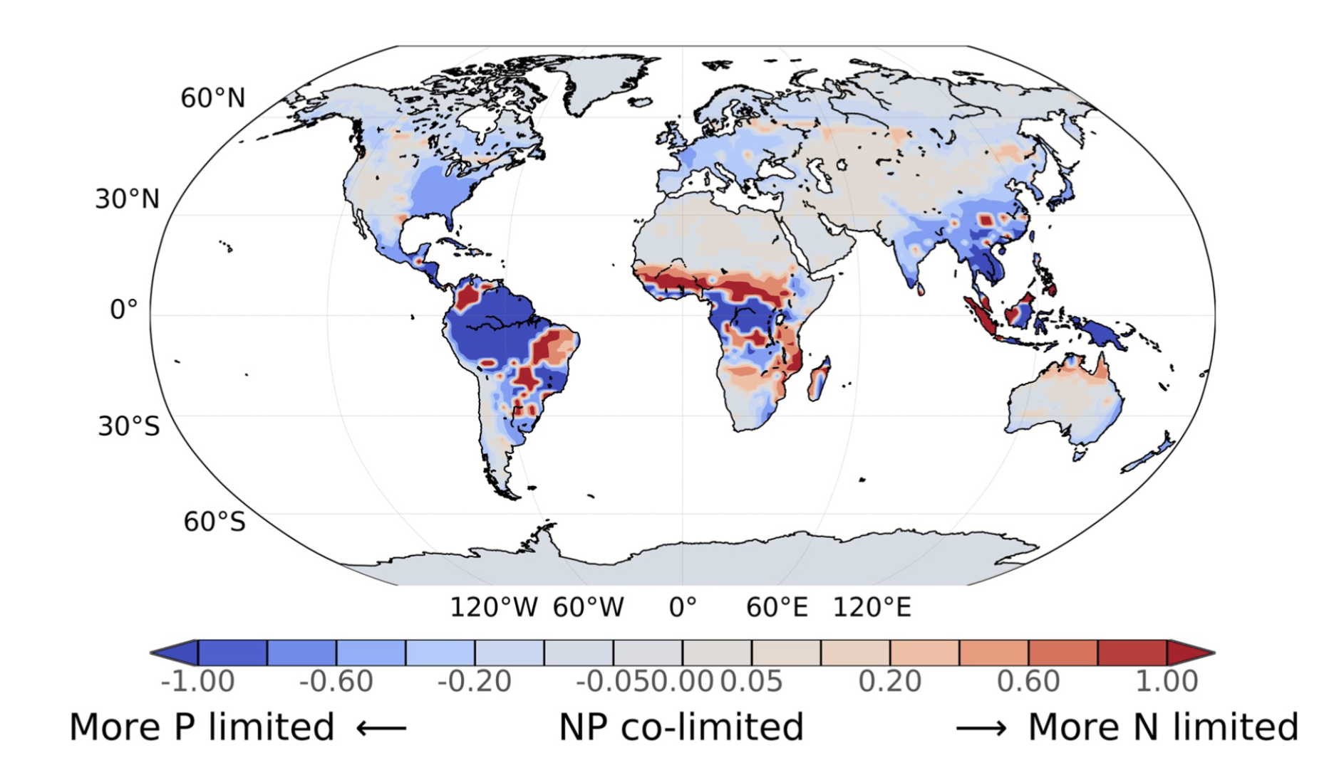
And what about N and P colimitation effects on plant ecophysiological traits?
Braghiere et al. (2022) JAMES
Notes:
Furthermore, if nitrogen and phosphorus similarly modify plant traits, then it would make sense that these nutrients might interact to modify plant ecophysiological traits across time and space
This may be particularly apparent in regions where traits are colimited by nitrogen and phosphorus, noted in this map through light blue and red shades.

Slide 23
And what about N and P colimitation effects on plant ecophysiological traits?
Braghiere et al. (2022) JAMES
Ellsworth et al. (2022) Nature Communications
Notes:
Indeed, there is some evidence to suggest that leaf nitrogen-photosynthesis relationships may at least be partially modified by phosphorus

Slide 24
We lack broad data syntheses that assess the role of phosphorus availability* on leaf and whole-plant ecophysiological traits
*individually and in combination with nitrogen availability
Notes:
This brings us to the main objective of this work, as we currently lack broad data syntheses that assess the role of phosphorus availability (individually and in combination with nitrogen availability) on plant ecophysiological traits

Slide 25
Meta-analytic approach
Full-factorial N*P experiments
(must have N, P, and N+P treatment)
Clear replication scheme
Measure relevant leaf nutrient, leaf photosynthetic,
or biomass allocation trait
Notes:
We conducted a meta-analysis where we collected data from nutrient addition experiments that added nitrogen and phosphorus in a full-factorial design.
There were a few criteria for experiments to be included in the meta-analysis:
Experiments must have a clear replication scheme and measure a relevant leaf or whole-plant ecophysiological trait.

Slide 26
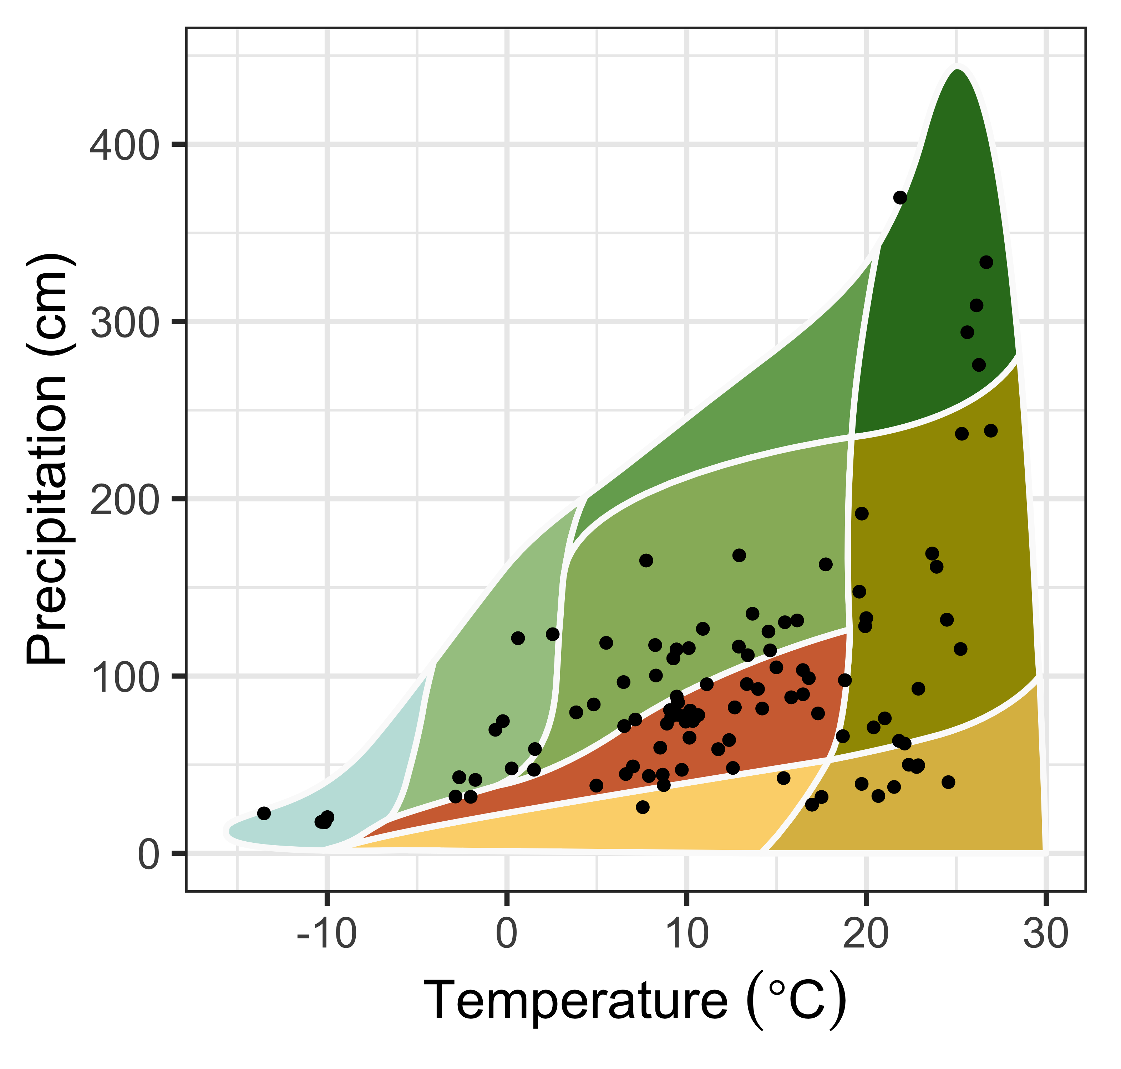
Final dataset
85 studies
78 field (166 sites)
6 greenhouse
1 growth chamber
Notes:
This effort resulted in 85 studies. 78 of these studies were field experiments, 6 were greenhouse, and 1 was a growth chamber experiment.
Of the field experiments, we treated site as an independent experiment, rendering 166 sites that spanned a diverse climate gradient

Slide 27
Main questions
How does N and P addition modify leaf and whole-plant traits?
How do N and P addition interact to modify leaf and whole-plant traits?
Are responses to N and P addition modified by climatic demand?
Notes:
We used this experiment to ask the following questions:

Slide 28
How does N and P addition modify leaf and whole-plant traits?
N addition increases leaf N content, does not change photosynthesis, but increases aboveground biomass and decreases the root mass fraction/root:shoot ratio
Notes:
Let’s hop right into our first question.
To orient you with how these plots are arranged:
- effect sizes of a given nutrient treatment on the x-axis, represented as percent change
- traits on the y-axis
- meta-analytic mean as big points with 95% confidence intervals as error bars
- number of observations in parentheses with a note on whether a given effect is significantly different from zero

Slide 29
How does N and P addition modify leaf and whole-plant traits?
N addition increases leaf N content, does not change photosynthesis, but increases aboveground biomass and decreases the root mass fraction/root:shoot ratio
Notes:
N addition increases leaf N content on a mass- and area-basis, but does not alter leaf phosphorus content

Slide 30
How does N and P addition modify leaf and whole-plant traits?
N addition increases leaf N content, does not change photosynthesis, but increases aboveground biomass and decreases the root mass fraction/root:shoot ratio
Notes:
N addition does not modify any index of photosynthesis, photosynthetic capacity, or resource use efficiency

Slide 31
How does N and P addition modify leaf and whole-plant traits?
N addition increases leaf N content, does not change photosynthesis, but increases aboveground biomass and decreases the root mass fraction/root:shoot ratio
Notes:
However, N addition increases aboveground biomass and does not change belowground biomass
Leads to a reduction in the root mass fraction and root:shoot ratio

Slide 32
How does N and P addition modify leaf and whole-plant traits?
P addition increases leaf P content, does not change photosynthesis, but increases aboveground biomass and decreases the root:shoot ratio
Notes:
Opposite from N addition, P addition increased leaf P content and did not change leaf N content

Slide 33
How does N and P addition modify leaf and whole-plant traits?
P addition increases leaf P content, does not change photosynthesis, but increases aboveground biomass and decreases the root:shoot ratio
Notes:
P addition still had no general effect on photosynthesis, photosynthetic capacity, or resource use efficiencies

Slide 34
How does N and P addition modify leaf and whole-plant traits?
P addition increases leaf P content, does not change photosynthesis, but increases aboveground biomass and decreases the root:shoot ratio
Notes:
Finally, P addition increased total biomass through increasing aboveground biomass and no change in belowground biomass.
Leading to a reduction in the root:shoot ratio

Slide 35
How does N and P addition modify leaf and whole-plant traits?
N+P addition increases leaf N and leaf P content, increases photosynthesis, and increases total biomass by increasing aboveground biomass more than belowground biomass
Notes:
When both N and P are added, we observe a significant increase in both leaf N and P content on both mass and area-bases

Slide 36
How does N and P addition modify leaf and whole-plant traits?
N+P addition increases leaf N and leaf P content, increases photosynthesis, and increases total biomass by increasing aboveground biomass more than belowground biomass
Notes:
There is a slight positive effect of N and P addition on net photosynthesis, but still no effect on resource use efficiency

Slide 37
How does N and P addition modify leaf and whole-plant traits?
N+P addition increases leaf N and leaf P content, increases photosynthesis, and increases total biomass by increasing aboveground biomass more than belowground biomass
Notes:
Finally, N and P addition increased total biomass through an increase in aboveground biomass and no change in belowground biomass
Led to a reduction in the root mass fraction and root:shoot ratio

Slide 38
How do N and P addition interact to modify leaf and whole-plant traits?
Notes:
Now onto our second question...

Slide 39
How do N and P addition interact to modify leaf and whole-plant traits?
N response
P response
N+P response
Plot interpretation
Additive interaction
2
1
3
95% CI range intersects zero
Synergistic interaction
Antagonistic interaction
Notes:
Before I get into results I want to briefly explain how to interpret interactions in meta-analytic techniques
An additive interaction occurs when the response of a treatment combination, in this case N+P addition, is the sum of the individual responses.
For example, if the effect size of a given trait for N addition is 2 and the effect size of the same trait for P addition is 1, an additive interaction would occur if the effect size for a given trait for N+P addition is 3
In meta-analyses, an additive interaction is indicated when the interaction effect size and its associated 95% confidence interval range intersects zero

Slide 40
How do N and P addition interact to modify leaf and whole-plant traits?
N response
P response
N+P response
Plot interpretation
Additive interaction
2
1
3
95% CI range intersects zero
Synergistic interaction
2
1
5
95% CI range > 0
(if ind. responses are positive)
Antagonistic interaction
Notes:
A synergistic interaction occurs when the response of a treatment combination is stronger than the sum of the individual responses.
For example, using the same effect sizes for N and P as the previous slide, a synergistic interaction would occur if the effect size for a given trait for N+P addition is anything greater than 3
In meta-analyses, synergistic interactions are indicated when the interaction effect size and its associated 95% confidence interval range is positive (if individual responses are positive)

Slide 41
How do N and P addition interact to modify leaf and whole-plant traits?
N response
P response
N+P response
Plot interpretation
Additive interaction
2
1
3
95% CI range intersects zero
Synergistic interaction
2
1
5
95% CI range > 0
(if ind. responses are positive)
Antagonistic interaction
2
1
0.5
95% CI range < 0
(if ind. responses are positive)
Notes:
Finally, an antagonistic interaction occurs when the response of a treatment combination is weaker than the sum of the individual responses.
Using the same effect sizes for N and P as the previous two slides, an antagonistic interaction would occur if the effect size for a given trait for N+P addition is anything less than 3
In meta-analyses, antagonistic interactions are indicated when the interaction effect size and its associated 95% confidence interval range is negative (if individual responses are positive)

Slide 42
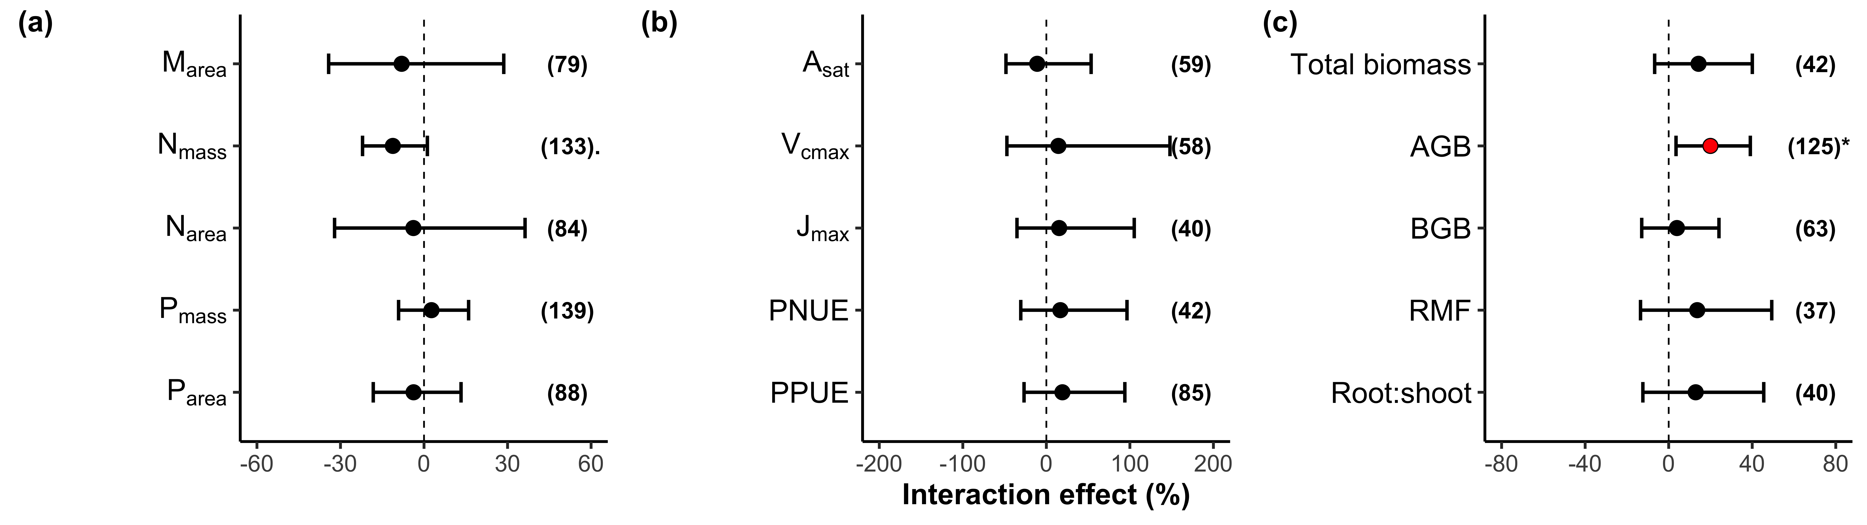
How do N and P addition interact to modify leaf and whole-plant traits?
Leaf nutrient, photosynthetic, and (mostly) biomass responses to N+P addition are driven by additive interactions
Notes:
Okay so getting to the results, we find overwhelming evidence suggesting that plant responses to N+P addition are the product of additive interactions.
In other words, the response of adding both N and P addition is no stronger or weaker than would be predicted by calculating the sum of the effect sizes of N and P addition alone

Slide 43
How do N and P addition interact to modify leaf and whole-plant traits?
Leaf nutrient, photosynthetic, and (mostly) biomass responses to N+P addition are driven by additive interactions
Aboveground biomass responses to N+P addition are driven by a synergistic interaction (i.e., stronger response than predicted from N and P responses)
Notes:
However, aboveground biomass responses to N+P addition did exhibit a stronger response than predicted from the sum of the individual effects of N and P addition.
This pattern is indicative of a synergistic interaction

Slide 44
Are responses to N and P addition modified by climatic demand?

Slide 45
Are responses to N and P addition modified by climatic demand?
Leaf nitrogen responses to N addition are strongest in cold, dry climates
Notes:
In dry regions, plants can maintain photosynthesis by increasing nutrient uptake and allocation to photosynthetic enzymes to make up for reduced water uptake
Similarly, decreased enzymatic speed under low temperatures increases demand to build and maintain photosynthetic enzymes to achieve a given photosynthesis rate while optimizing light use efficiency.

Slide 46
Are responses to N and P addition modified by climatic demand?
Leaf phosphorus responses to P addition are strongest in cold, dry climates
Notes:
In dry regions, plants can maintain photosynthesis by increasing nutrient uptake and allocation to photosynthetic enzymes to make up for reduced water uptake. This strategy effectively allows plants to trade inefficient use of a more abundant resource for more efficient use of a less abundant resource
Similarly, decreased enzymatic speed under low temperatures increases demand to build and maintain photosynthetic enzymes to achieve a given photosynthesis rate while optimizing light use efficiency.

Slide 47
How does N and P addition modify leaf and whole-plant traits?
N addition increases leaf N content, P addition increases leaf P content
Leaf level photosynthesis largely unaffected by N or P addition
N and P addition increase aboveground biomass and decrease relative investment in belowground biomass
How do N and P addition interact to modify leaf and whole-plant traits?
Plant responses to N and P addition largely driven by additive interactions
Aboveground biomass response was driven by a synergistic interaction
Are responses to N and P addition modified by climatic demand?
Leaf nutrient responses to nutrient additions were strongest where demand was highest (cold, dry climates)

Slide 48
Extra slides

Slide 49
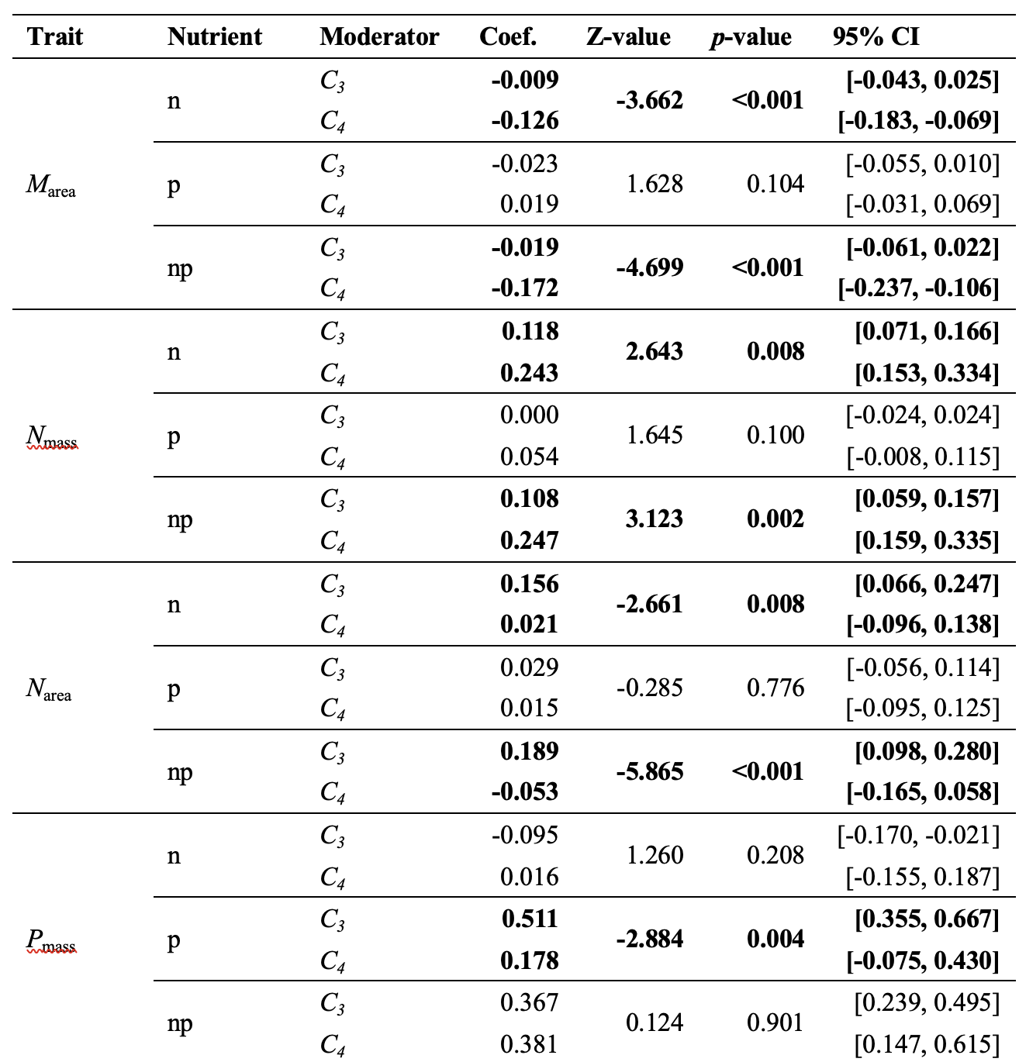

Slide 50
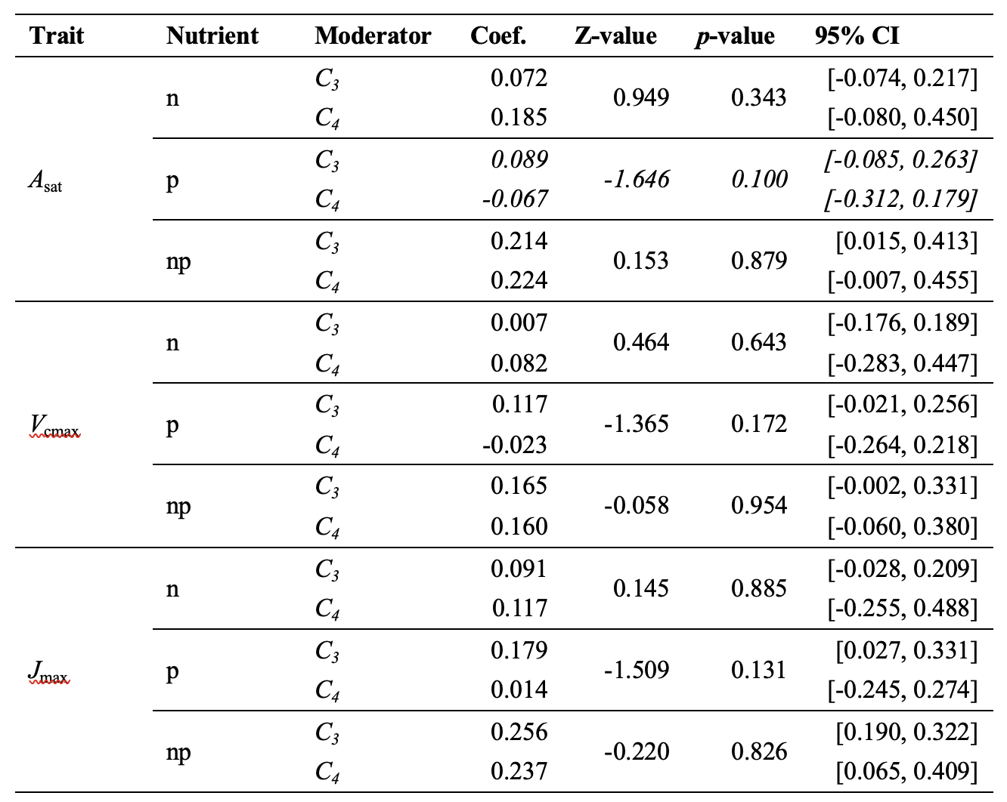

Slide 51
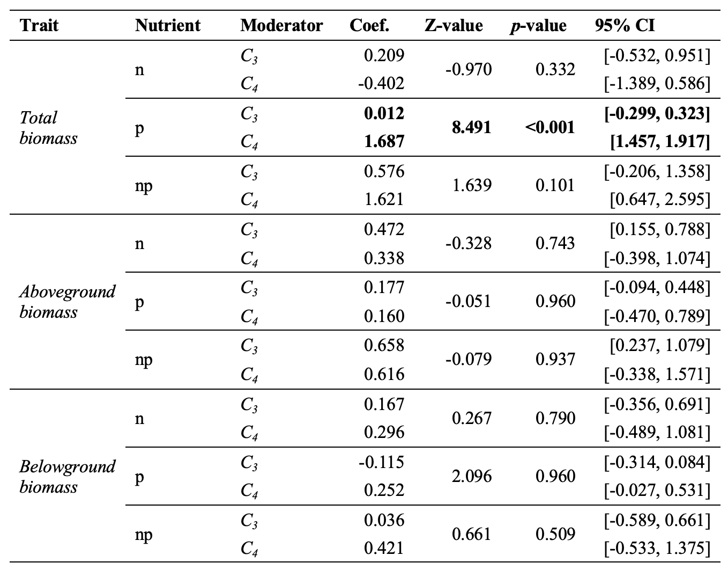

Slide 52
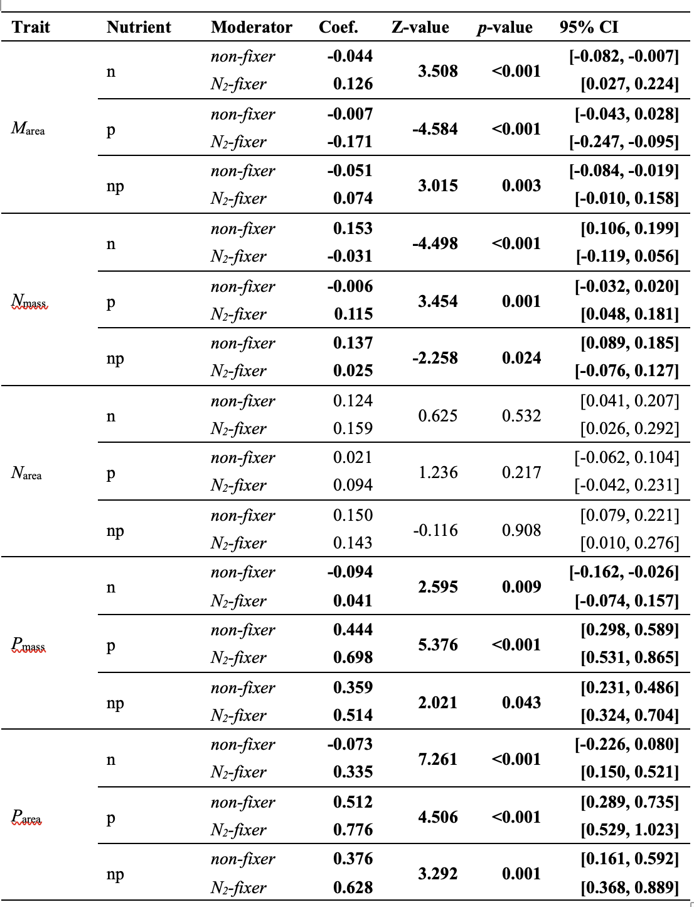

Slide 53
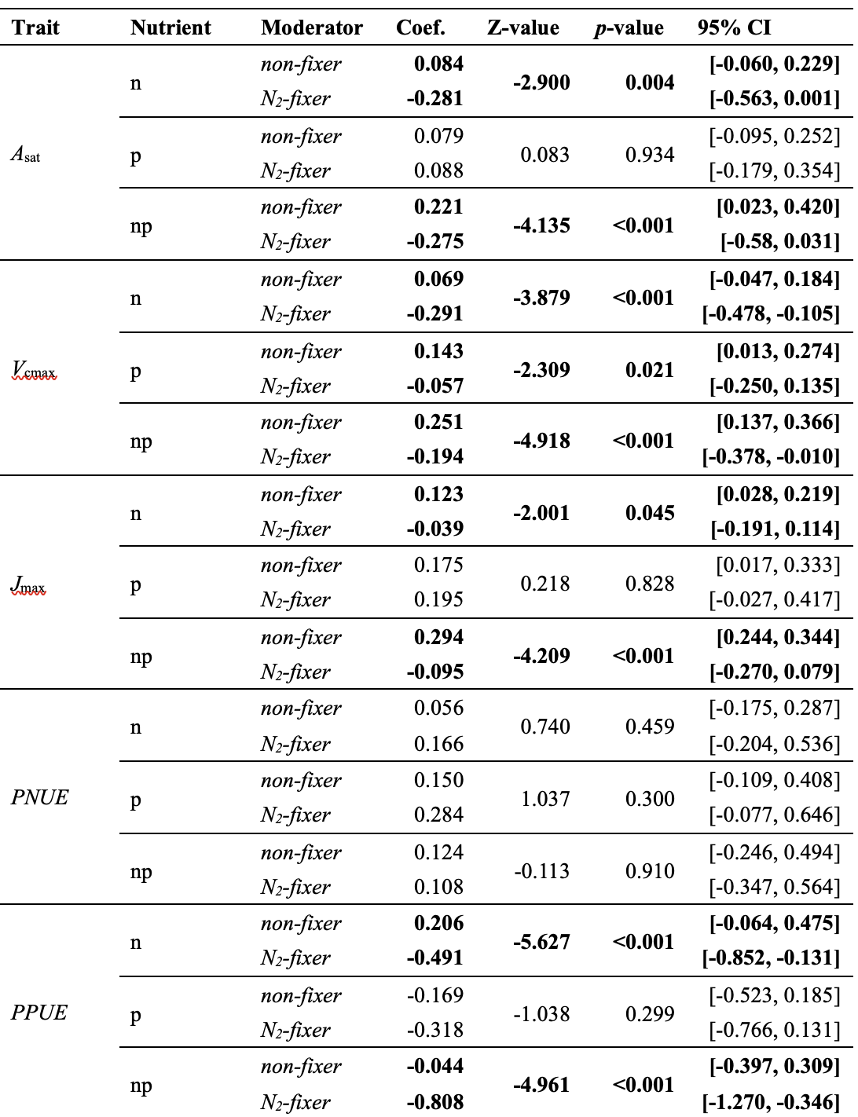

Slide 54
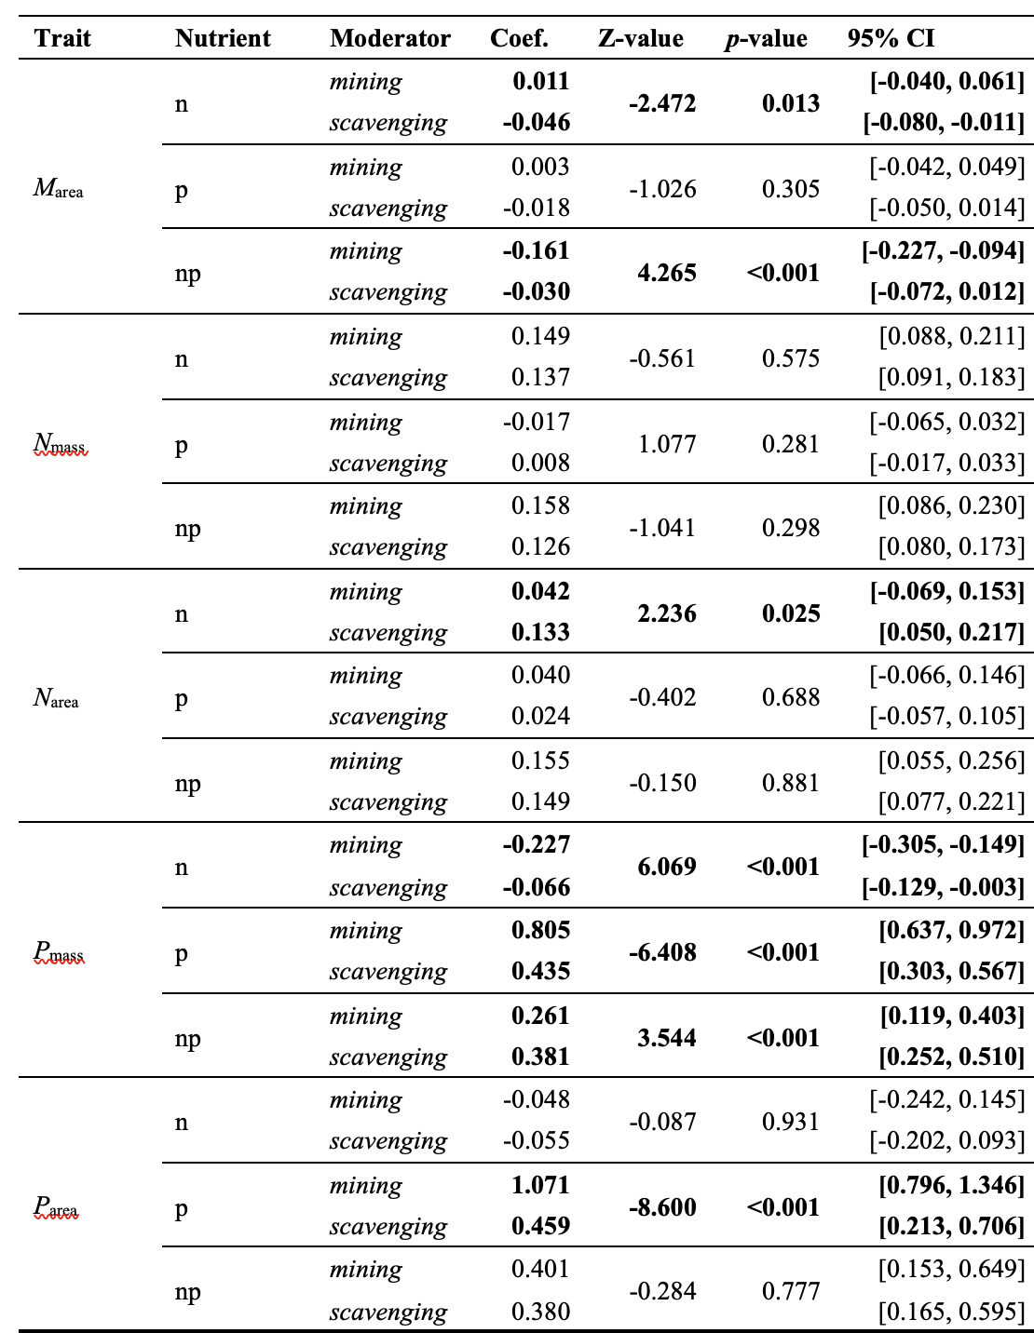

Slide 55
